Slide 1


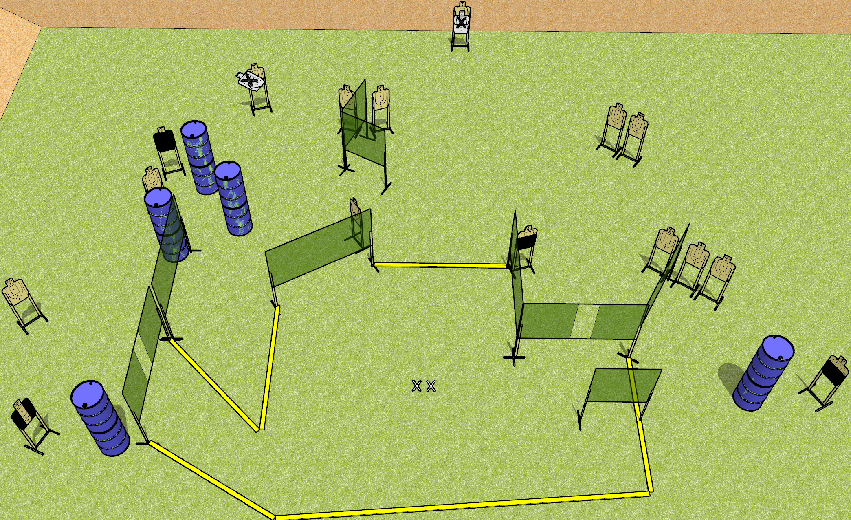
 | Dothan Gun Club – USPSA Match Sweet Dreams Course Designer : Drew Coleman
32 rounds 16 USPSA targets
Equipment List 15 wall feet 1 tuxedo, 2 50% OR action target, 1 headshot

Slide 2
Sweet Dreams
Written Stage Briefing
Sweet Dreams is a 32 round, 160 point, Comstock field course. There are 16 USPSA targets. The best 2 hits on paper will score, and steel must fall to score. The start signal is audible.
Handgun start position is both feet on X’s, wrists below belt. Handgun is loaded and holstered.
PCC start position is both feet on X’s. Loaded carbine is held with both hands, stock on belt, safety on.
On start signal, engage targets as they become available from within the shooting area.

